Slide 1
ES6 Features
JavaScript

Slide 2
What is ES6?
Because JavaScript as a language is implemented in so many different web browsers and kinds of software, it was important that it follow a universal standard. This standard ended up being: ECMAScript.
Currently, the modern standard for JavaScript is ECMAScript 5.1 (ES2012) and newer, however a few of the most popular browsers have implemented much of the ECMAScript 6 (ES2015) standard features into their JavaScript engines. This adds a lot of niceties and additions that we can incorporate into our code as we continue to explore JavaScript—in fact, we’ve already been using some! const, let, rest parameter, and classes are all an ES6 addition, for instance.
Newer standards are currently underway, so it is important to keep an eye out for updates! We tend to focus in courses like this on ES6 updates as it was a very substantial update, but there are other additions provided by ES7 (ES2016), ES8 (ES2017), ES9 (ES2018), ES10 (ES2019), and ES11 (ES2020) that may not yet be added in-full to all browsers—but they will become integrated sooner than you’d think!

Slide 3
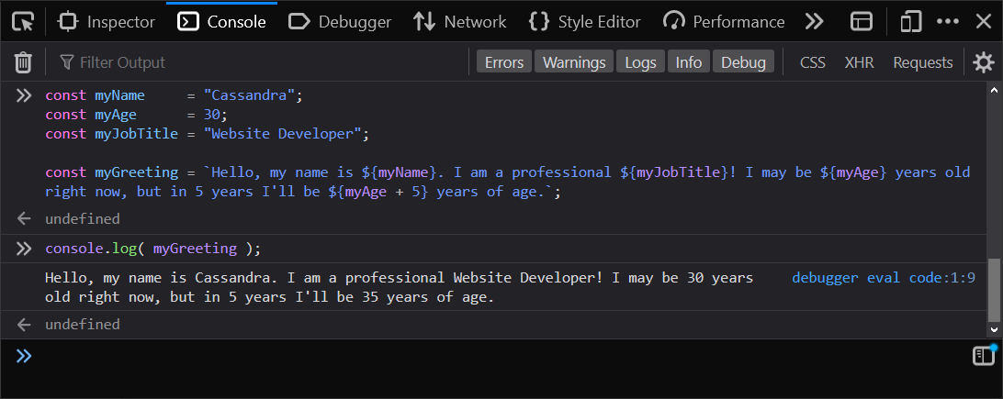
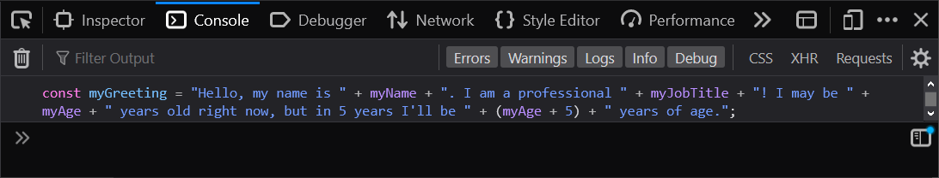
String Interpolation
Template literals / template strings use backticks (`) instead of quotes (‘ / ”).
Inside of backticks we are able to use a dollar-sign (${}) followed by curly braces to inject the result of an expression into our string.
The expression must be entered between the curly braces.
Try the following example, compare the traditional way with this new way of formatting your strings.
Instead of traditional concatenation with the plus (+) symbol, we can utilize template literals to glue strings together.
Notes:
What are some advantages to using template literals?
The alternative would have been…
const myGreeting = "Hello, my name is " + myName + ". I am a professional " + myJobTitle + "! I may be " + myAge + " years old right now, but in 5 years I'll be " + (myAge + 5) + " years of age.";

Slide 4
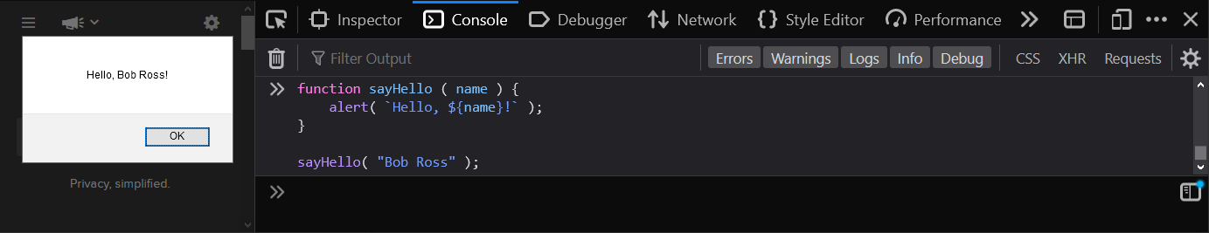
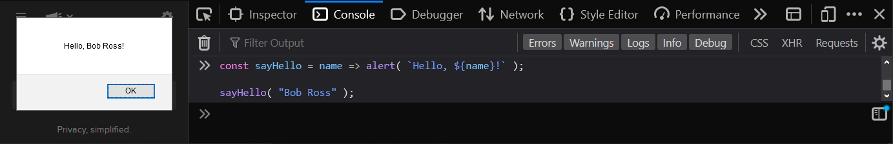
Arrow Functions
A new syntax is available for functions that in certain cases may make your functions shorter and cleaner. Functions following this syntax are referred to as arrow functions.
It is also important to note that there are a few differences in how traditional, and arrow, functions work. Most notably, in what we’ll be covering, they are not afforded local function-based “this” context and keyword.
There are a few options available for writing these functions, depending on a function’s complexity.
Let’s compare a basic traditional function declaration…
...with one using the arrow syntax:
Notes:
This ends up being quicker and easier, especially for small functions.
function sayHello ( name ) { alert( `Hello, ${name}!` ); }
const sayHello = name => alert( `Hello, ${name}!` ) );

Slide 5
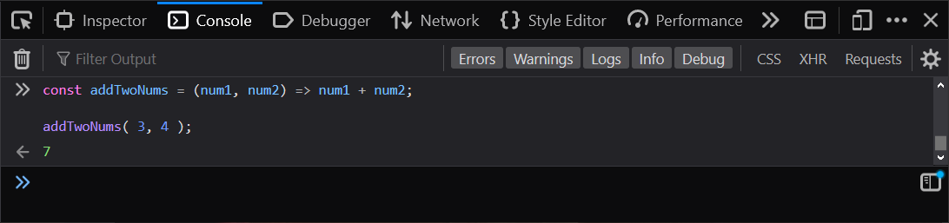
Arrow Function Parameters
Look closely at the difference when dealing with one, versus many, parameters in an arrow function.
One parameter…
More than one parameter…
Note: you can always use parentheses—even if there is only one parameter—with no ill effect.
If you have only one parameter, you don’t need to wrap it in parentheses.

Slide 6
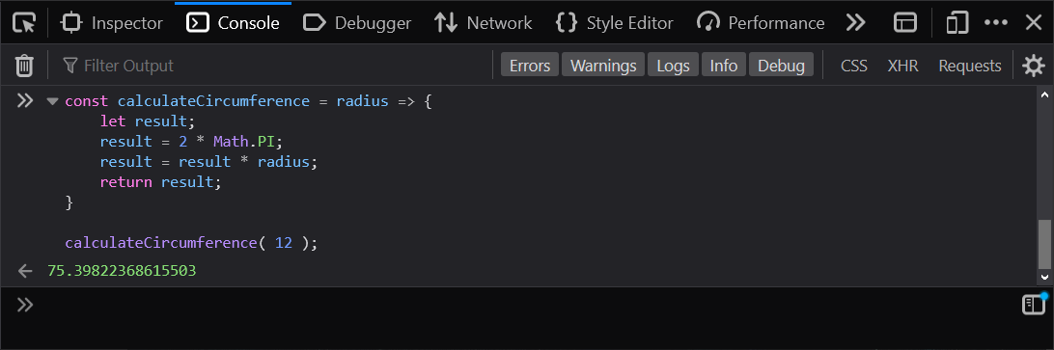
Arrow Function Returns
The expression following the arrow (=>) in your function is returned by default unless it is a code block—meaning that what follows is wrapped in curly braces.
Let’s compare a one-line arrow function that returns the expression…
...with one that is a little bigger and may warrant a code block and the return keyword.
Simple one-line arrow functions don’t demand a formal code block containing the return keyword.

Slide 7
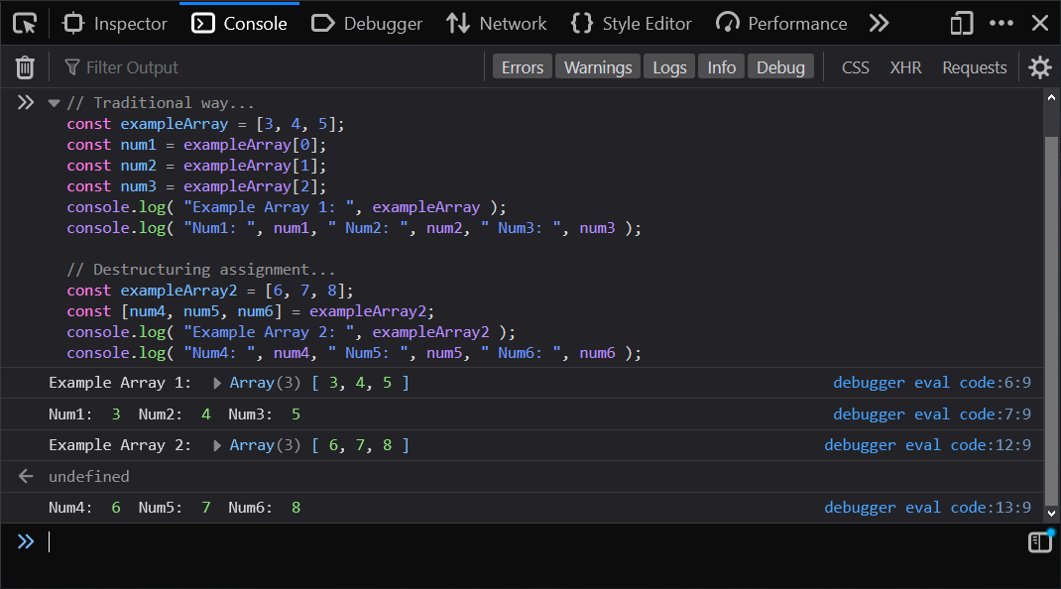
Destructuring Assignment for Arrays
A destructuring assignment helps us more quickly and easy assign all the individual values in an array to individual variables.
Note that the declaration keyword (const, let, var) you precede the square bracket list of variable names with will be applied to each, so be mindful of which one you choose for your solutions.
You can quickly assign multiple values to respective variables all at once by enclosing the variable names in square brackets ([]) during the assignment.
Notes:
Destructuring can come in very handy when dealing with parameters or third party data-sets. This simplifies the names you use to call upon your target data—using

Slide 8
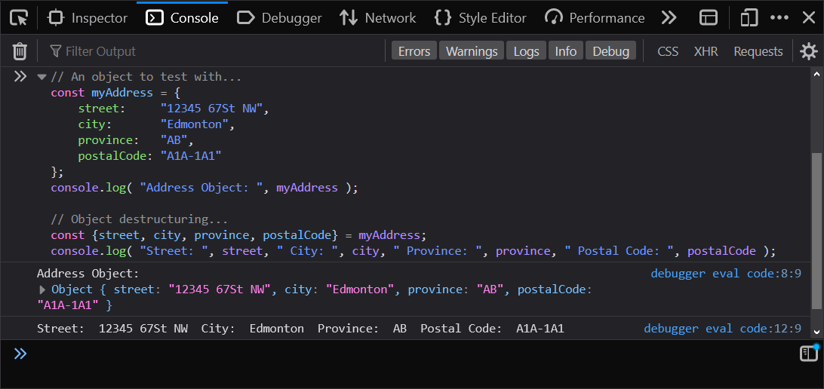
Destructuring Assignment for Objects
Destructuring assignments are not exclusive to arrays, they can also be used in the context of objects for swiftly collecting property values and assigning them to respective variables.
Note that in this case we place the variable names within curly braces ({}) instead of square brackets.
Objects can also be destructured and assigned at once, with a very comparable syntax.

Slide 9
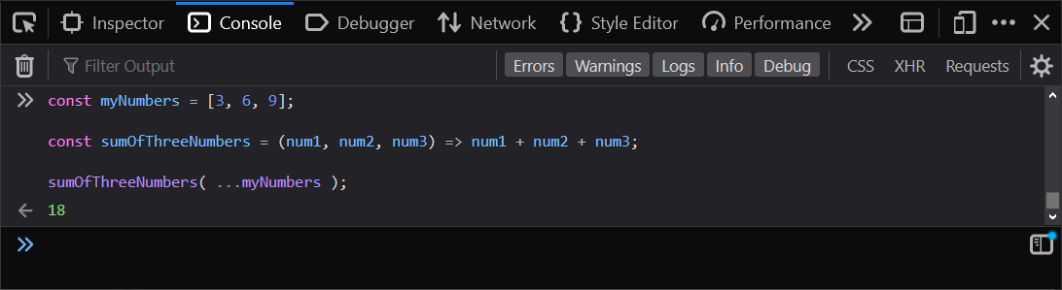
Spread Operator
Careful not to confuse the spread operator with the rest parameter syntax. They look almost identical, but they are used in different parts of your code for different purposes.
Note that the previously covered rest parameter is used as a parameter when declaring a function.
The spread operator is typically used on an argument, to expand its values into multiple arguments.
See the following example, note how the array transforms into the expected 3 arguments…
To expand an iterable value (like an array)—usually for passing into a function or method as arguments—we use the spread operator!

Slide 10
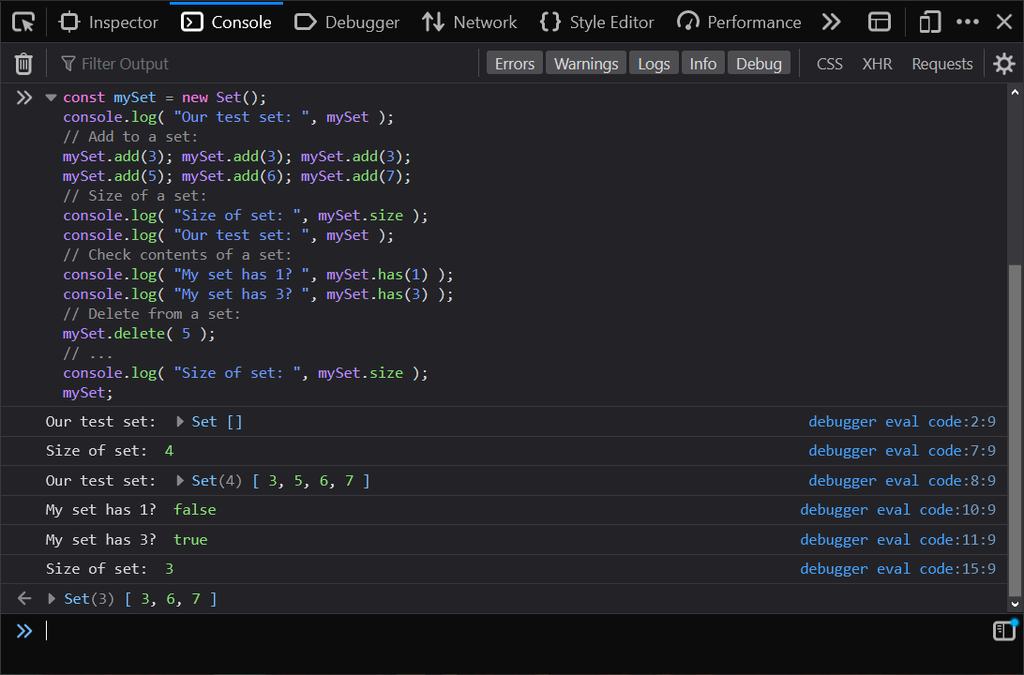
Sets
Much like an array, we can work with data lists as a set.
We do have to use different methods than we do with an array to manipulate a set object’s context.
If you require an array that only has unique values (no duplicates), a set is more appropriate.
Notes:
Note that when you add duplicates, the additions that match pre-existing values are ignored!
You can store primitives and objects.

Slide 11
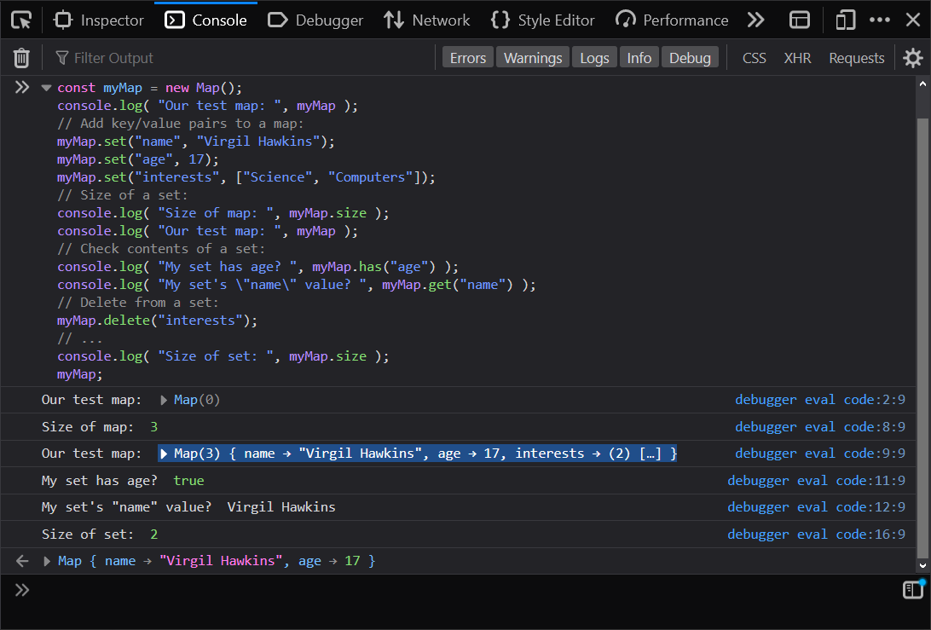
Maps
This way of organizing data is more familiar if you enjoyed creating a basic object.
Each item must have a unique key, used to access its value.
If you want to store data in a more descriptive fashion (using key names instead of index numbers), maps have you covered!

